Slide 1
SIMPLE SNAKE GAME
M ABDULLAH KHAN (BCPE243016)
ABDUL RAFAY ( BCPE243029)

Slide 2








Slide 3








Slide 4
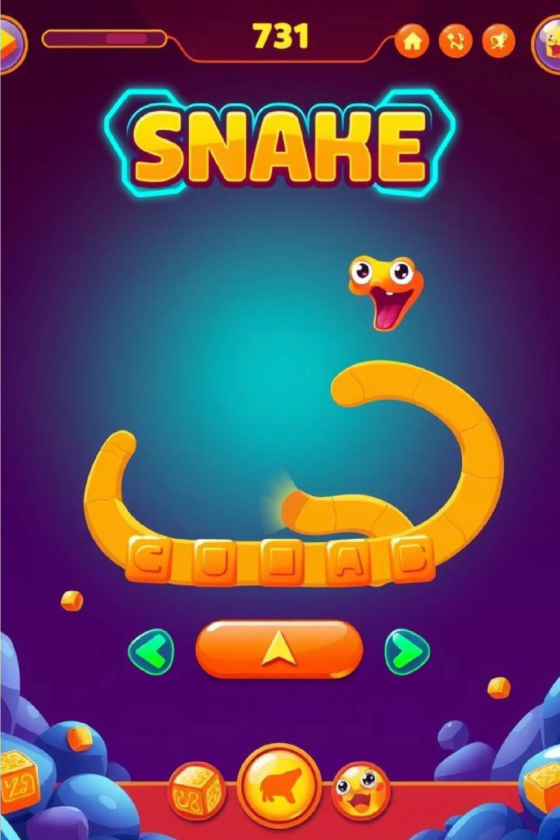










Slide 5
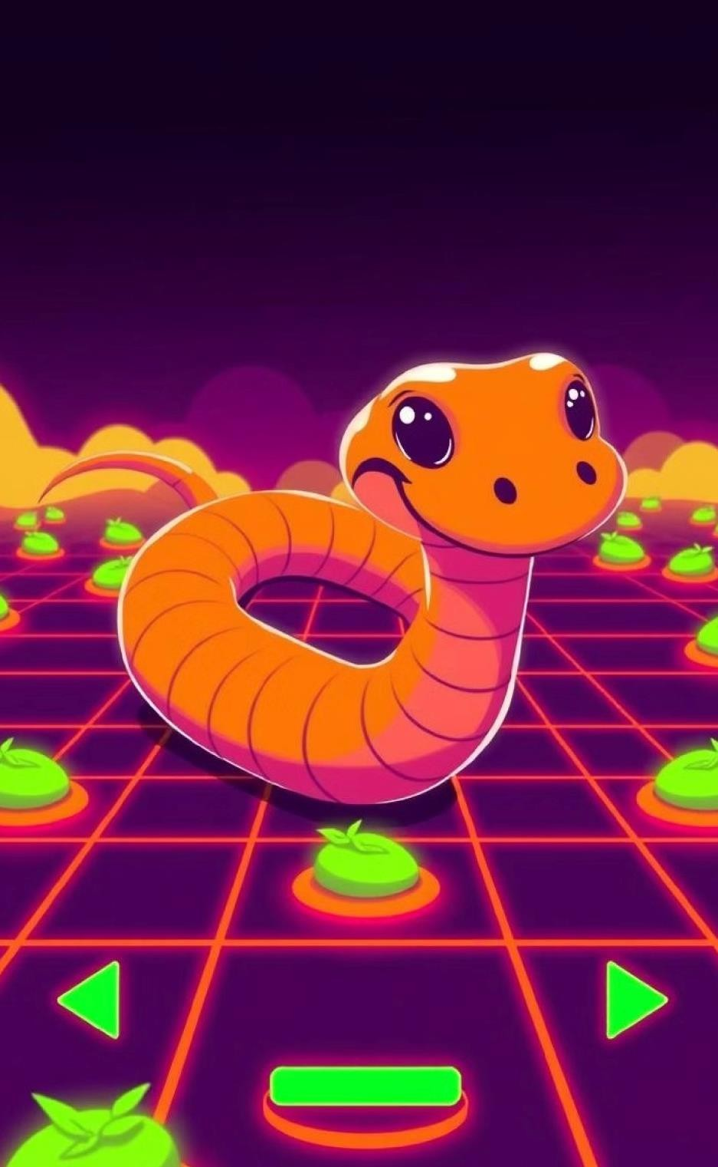










Slide 6










Slide 7
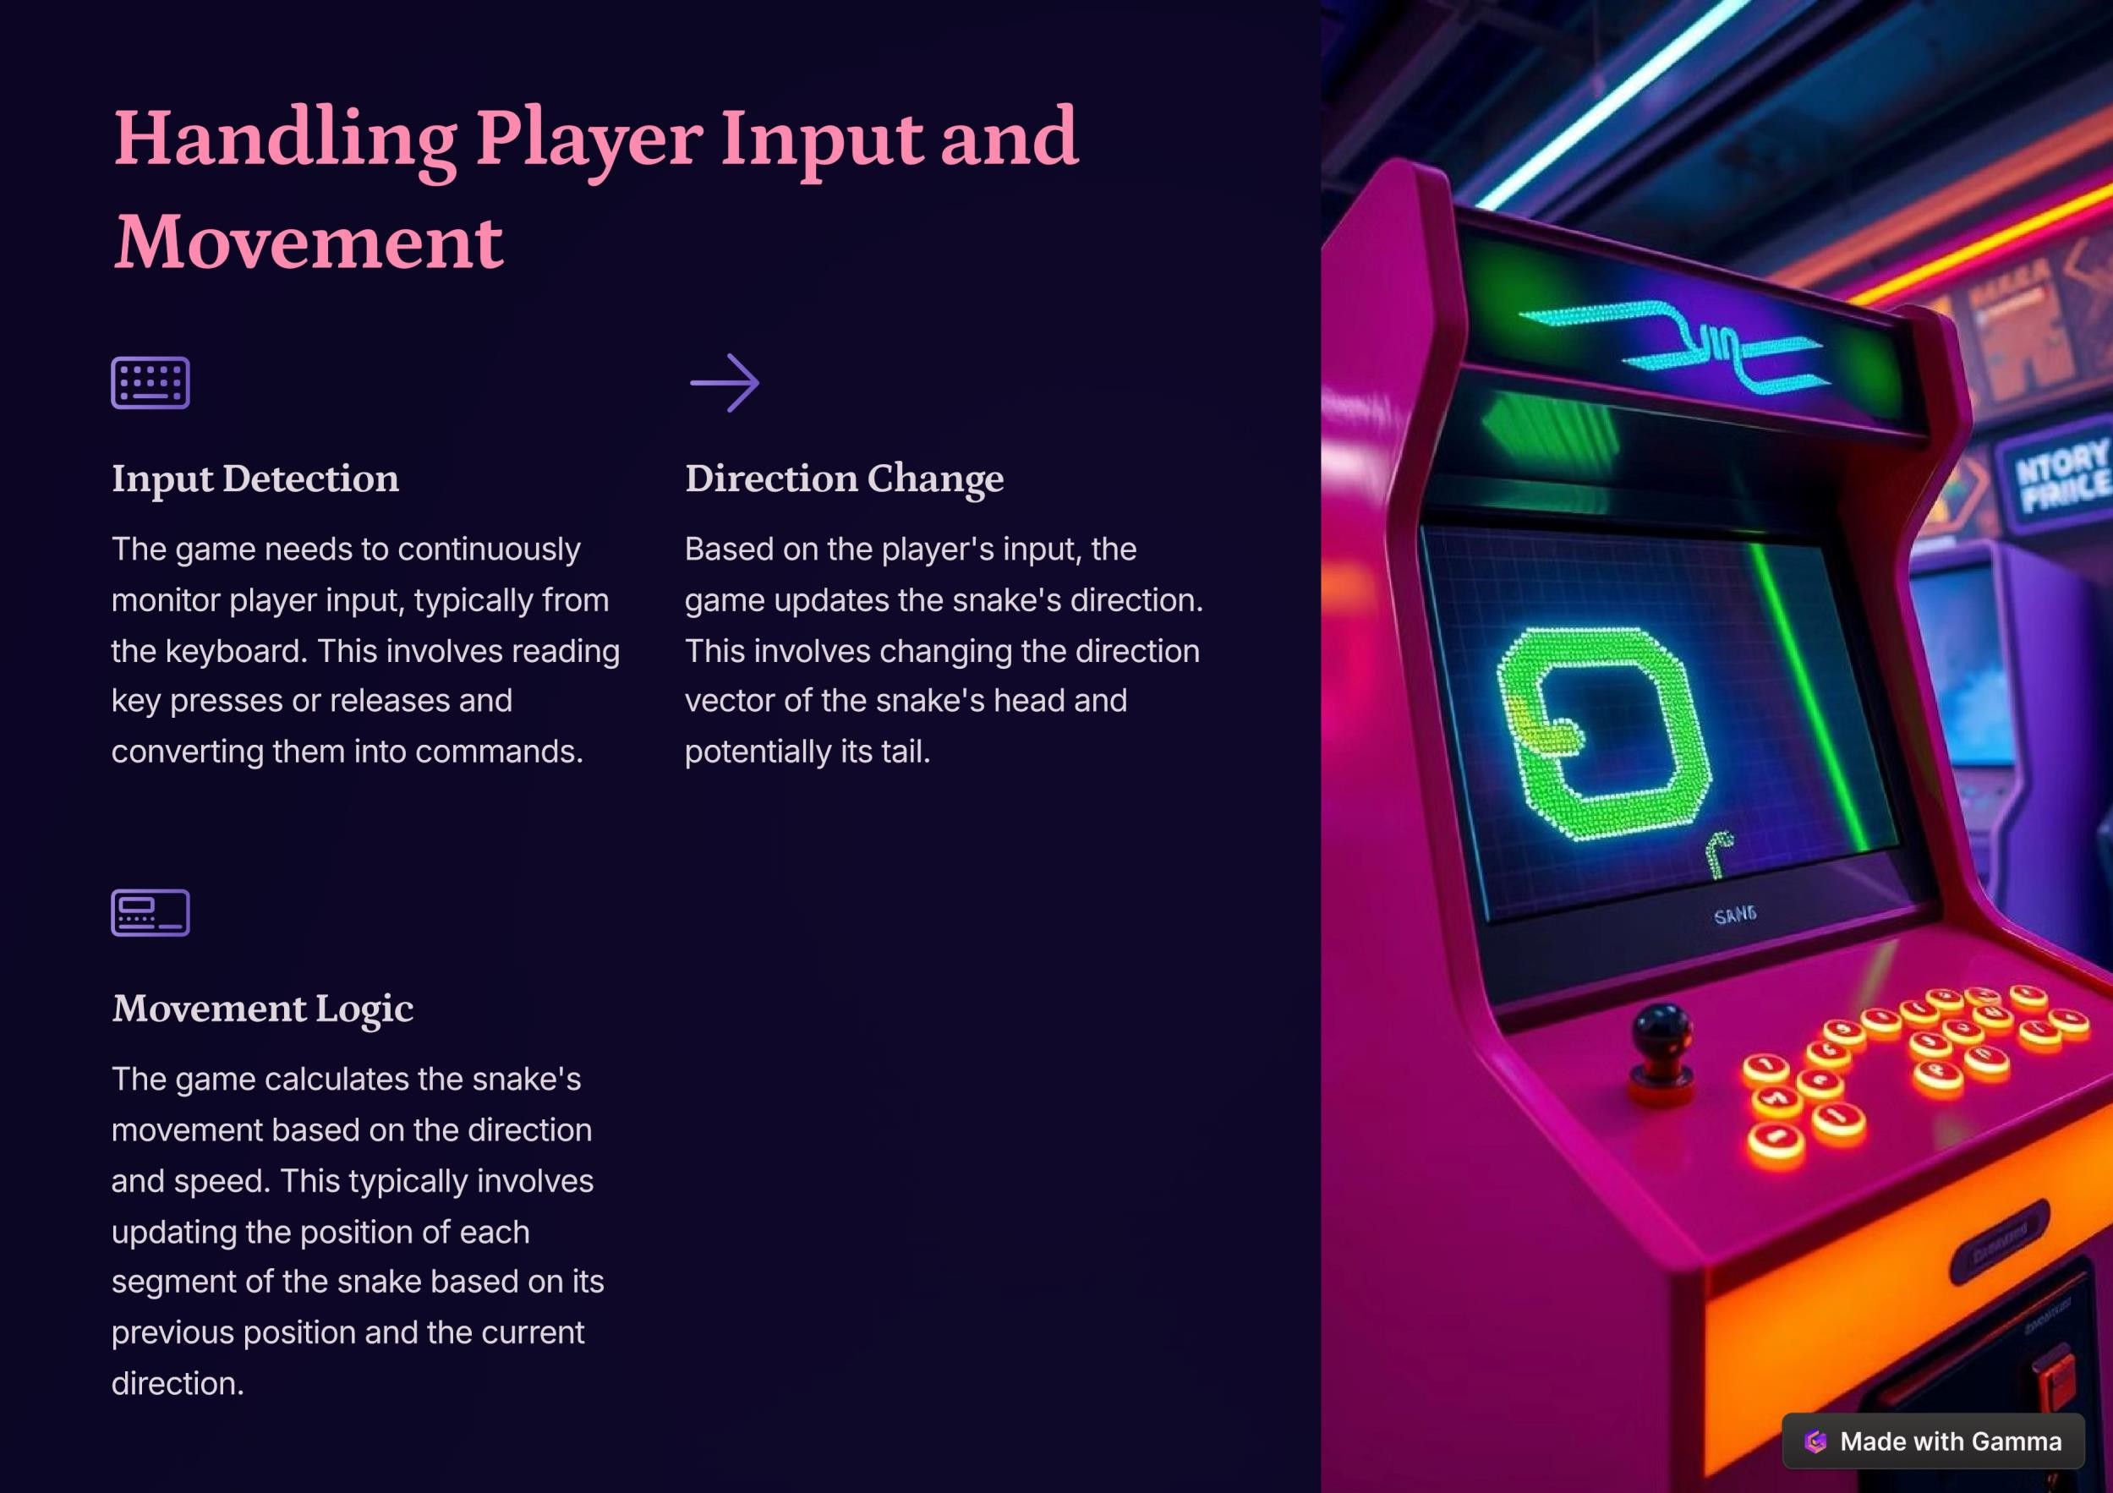

Slide 8











Slide 9









Slide 10
THANKS

